Slide 1

Linux Network Defence Evasion
Offensive Security Tactics for Linux Professionals
Notes:
So hello everyone, this is my presentation for bypassing defences within an internal network using IPv6

Slide 2
Agenda
1. What is IPTables, why do we use it and its role in network security?
2. Best practices of IPTables configuration
3. Use case example of IPTables
4. IPv6 host reconnaissance techniques
5. IPTables bypassing and VLAN Hopping
6. Recommended patches
Notes:
Just a quick agenda of today’s presentation. Starting with what is IPTables and why it’s important, the best ways to configure IPTables, some use case examples of IPTables. Moving onto IPv6 security involving how to discover IPv6 hosts on an internal network, how to bypass IPTables and hop VLANs in addition to recommended patches.

Slide 3
IPTables?
A user-space program which can be used to configure firewall rules for a server, preventing/filter network traffic. IPTables is hooked to the system kernel and is a native Linux firewall to enforce rules.
IPTables (Firewalls) are NOT the ultimate solution to your network security. Rather firewalls are a first line defence which are only as strong as their configuration.
Can be bypassed via alternative communications channels such as IPv6 if misconfigured and SSH tunnels if firewalled machine is compromised.

Slide 4
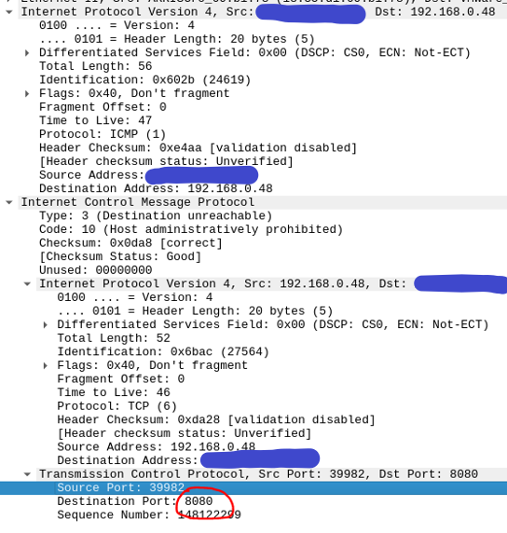
REJECT vs DROP
Notes:
So as we can see, on the INPUT chain which is regarding incoming traffic, if any machine tries to make ICMP contact then it should receive REJECT packets. REJECT packets give out messages which can reveal that the host is active and a firewall is in place. This can be done using traceroute and even using Wireshark when targeting specific ports.
When targeting specific hosts we can see certain ports which are internally listening on a server and behind a firewall can reveal their presence to devices performing queries from the internet. This extract is from a previous engagement in which an internal port is exposed. Although this is not a critical vulnerability, this can help us to be able to discover information on internal hosts.

Slide 5

Use case of IPTables DROP (InfluxDB)
Accepting traffic from the loopback interface
Drop all packets which are going to attempt coming in. DROP will not give a message back.
Notes:
So an IPTables ruleset which is in place shows traffic firstly being accepted in the loopback interface. This is so the Influx database is able to have an interface which a connection be established and Influx can do its job to store data from internally developed software.

Slide 6
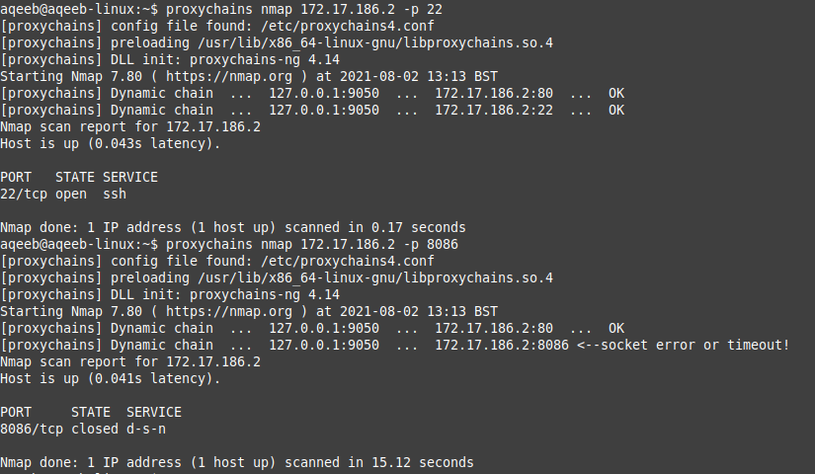
Attempts of reaching InfluxDB

Slide 7
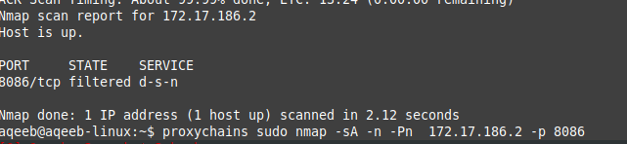
Attempts of reaching InfluxDB
Notes:
Previously by making a standard TCP connection we saw a closed state. However, by sending an ACK packet we are able to confirm that the port is definitely filtered. We can try a few other scans to confirm it’s definitely filtered.

Slide 8
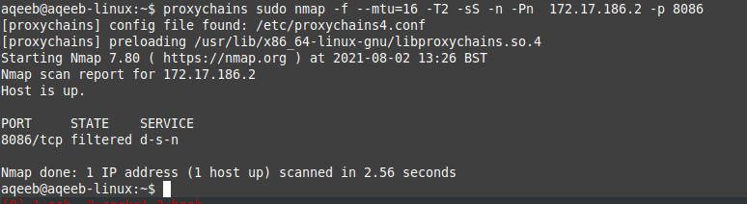
Attempts of reaching InfluxDB (Bit of stealth)
Notes:
We try to be a little stealthier here. Sending in packets to the internal network machine via fragmentation, with a slower timing in addition to a stealth scan known as a SYN scan. This scan is not a proper TCP connection and if the firewall is not configured to capture what are known as exotic scans, it is possible to confirm the port is definitely not reachable by testing a variation of responses.
Stealth is always the key when performing an actual red team engagement or penetration test to ensure defences aren’t triggered and you’re able to stay within the network.

Slide 9

Offensive Security
Notes:
So now the time has come for some offensive security. We know the port we’re trying to reach is blocked by IPv4 but we have not yet tested IPv6. This penetration test covers the process of reconnaissance of IPv6 hosts when IPv6 information is not readily available from DNS, leading onto making direct contact with a supposedly secure port.

Slide 10
Firewall enumeration
Observing the responses of a port can be vital to see if it is firewalled or not.
A port can be open or closed and the connect function in a network socket will report that immediately.
In the event of a firewall placement: The socket hangs and gives a timeout, a script has been developed to test this functionality: https://github.com/aqeebhussain122/portninja/blob/master/code/recon/iptables-enum.sh
Notes:
Observations of port behaviours can be enough to distinguish if a firewall is in place. An adversary leaves no stone unturned when approaching a network and by observing these responses, an adversary can prepare for the stage of defence evasion. This is a stage of stealth in which defences are subverted and target services are accessed in unintended means.

Slide 11
Protocols/Tools leveraged
ICMP (Discovery stage 1)
ARP/NDP (Discovery stage 2)
IPv6/BASH Shell (Components to make payload to perform contact with firewalled port)
Notes:
So a quick overview of the protocols which were leveraged then. The use of ICMP was firstly used in the first stage of discovery, followed by layer 2 protocols known as ARP and NDP. At the end of the discovery stages the required information was then gathered against the target which led to leveraging IPv6 within the internal network and a pseudo device file in BASH to perform a direct port scan to reveal the status of the port as open.

Slide 12
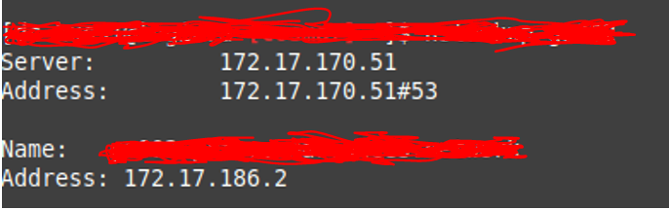
Host Reconnaissance – Usual Approach
Let’s try an nslookup of our target. But wait… NO IPV6!!!
Notes:
So let’s try to do a quick nslookup and see if we can get any IPv6 addresses. We cannot. The reason for this is that internal networks may not always have IPv6 addresses enabled via DNS. However. Just because IPv6 is not visible via DNS does not mean it cannot be available for use in the network and leveraged in an offensive security manner

Slide 13
NO DNS? No problem.
Pinging the host with the known IPv4 address fills in what is known as the ARP (Address Resolution Protocol) table revealing IPv4, MAC addresses and primary physical link name of the target.
1.
2.
MAC Address
Physical link
(We need these!)
Notes:
So how do we get around this? We can ping the host itself via the known IPv4 address leveraging ICMP and ARP in order to get further information which we’re going to need: The MAC address which will be a necessary piece of information to gaining the IPv6 address in addition to the physical link in which the machine is attached. This physical link is what links the hosts together in the IPv6 protocol through “link local” addresses. These addresses can be dumped in order to find the IPv6 address, however; for this to happen the MAC address is necessary for a cross check.

Slide 14
Link Local Addresses (IPv6)
IPv6 is a much bigger workspace than IPv4 having an address space of: 340,282,366,920,938,463,463,374,607,431,768,211,456
Link local addresses act as multicast addresses and direct links to neighbour machines on the physical link. Reducing the discovery horizon largely
The protocol used to discover and map such addresses is known as NDP (Neighbour Discovery Protocol)
Notes:
So one vital part of this attack is a part of IPv6 which is known as link local addressing. Link local addresses are very specific addresses within an internal network which are mapped to specific devices which reside on the same link. Without link local addresses, the scanning time and traffic generated would be very large to discover an IPv6 host but since IPv6 is already configured, these link local addresses need to be contacted using ICMPv6 using the link local notation of: “ff02::1”

Slide 15
Leveraging IPv6
Using a node on the internal network, we send a neighbour solicitation message revealing the link local addresses of all neighbouring hosts
IPv6 enabled neighbours see this message and respond accordingly with an NA (Neighbour Advertisement) message in which their link local addresses are sent.
Once this conversation is done, this populates the NDP table on the node, allowing a full view of all IPv6 addresses mapped to their own MAC addresses.
Notes:
We make use of two important parts of the IPv6 protocol. A neighbour solicitation message to gather all link local addresses of neighbouring hosts.

Slide 16
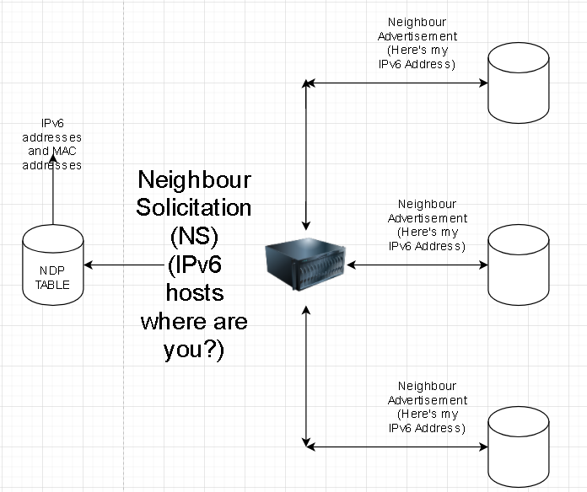
IPv6 host discovery procedure

Slide 17
Payload to populate NDP table
ping6 -I (Physical Interface name) -c 4 ff02::1
Notes:
Taking the name of the physical interface which your device and the device with the IPv6 address are both on. This gets included into the physical link. We issue ping packets to accurately discover IPv6 neighbours.

Slide 18
NO DNS? No problem.
Using “ip neighbour” with filtering tool “grep” with knowledge of the target IPv4 address we can map the MAC address which will help us to gain the IPv6 address
We have the IPv6 address!
Notes:
So the workaround? The IP suite provided by Linux which has a component called neighbour. By using IP neighbour we can perform queries on the server and find neighbour devices. As a result, we can dump IPv4, IPv6 and MAC addresses which can support the reconnaissance phase. We are after the link local address of our target. This address for our target as well as all the other hosts represents the IPv6 address being used on the same physical link. In addition to our key target, we also have a list of other hosts which we can target in order to locate further assets on the network such as outdated services firewalled by the IPv4 channel but could be accessible by IPv6.

Slide 19
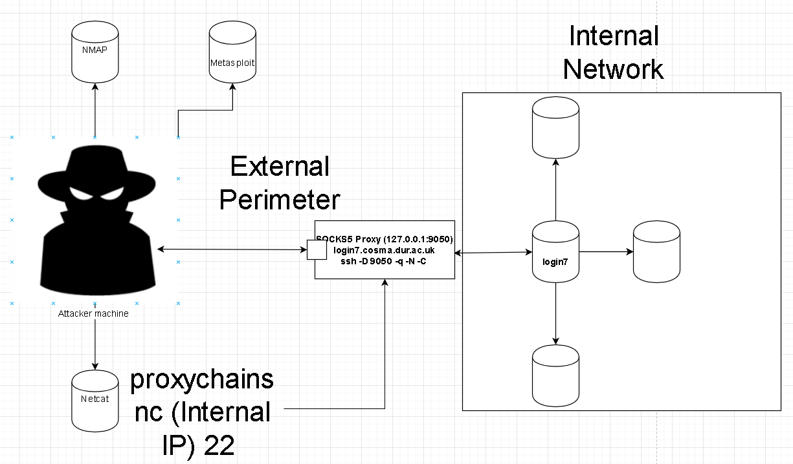
Port scanning – Internal network
Notes:
So the usual method and most efficient one which I have found when investigating methods of network pivoting is to use a SOCKS proxy into the internal network. A SOCKS proxy is capable of sending TCP/UDP protocols to a machine of your choice which acts as a proxy. SOCKS can work together with SSH by using an option called dynamic port forwarding in which all attached hosts to the proxy machine can be accessed by the localhost port of 9050 from the attacking machine, this can be achieved using a tool called Proxychains-ng.
Proxychains-ng can also help us to use external tools against internal hosts of the network. Depending upon which tool we use, we can raise unnecessary levels of noise and even have plain text conversations which is definitely not recommended for an adversary actively infiltrating the internal network. As monitoring defences could capture any commands/payloads being transferred if the adversary chooses to do so.
For port scanning, there is nothing wrong to use NMAP via SOCKS proxy but NMAP can generate lots of additional noise. It is recommended to make use of the netcat binary in order to perform port binds/scans from the external perimeter via SOCKS due to the minimal noise generation of this tool. Netcat will generate 1 to 2 packets where as NMAP will be a lot louder, potentially triggering port scan defences which monitor high volumes of packets to scan ports and can cause a trigger in firewall rules.
In this case, the external perimeter was not able to reach the host via IPv6 due to limitations of support with Proxychains and NMAP in addition to the fact the address is link local so likely not reachable from outside via proxy, only the physical link.

Slide 20
Issues with scanning from the outside
Scanning from our SOCKS proxy was not possible since the addresses were link local. (Available only to the physical link)
SOCKS does not allow ICMP traffic in/out to pass through
Time for some internal port scanning (Living off the land) tactics

Slide 21
Port scanning – Internal network
CORE DUMPED!
Timed out!
Notes:
In cases where SOCKS is not possible such as physical pentesting or limitations of traffic within the internal network, it’s vital to adapt with LOTL tactics which can involve port scanners to be custom built using languages like Bash and Python in order to perform the port scans which was an approach that had to be taken in this case to leverage IPv6.
The reason for this was that in our case, we’re up against an IPv6 address. Proxychains and NMAP do not work so well together and when attempting to scan an IPv6 address via proxy, NMAP reports a “core dumped” message within its binary, which means it’s time to resort to LOTL tactics. As a result, we can make use of /dev/tcp in BASH. I will discuss this further in the next slide.

Slide 22
/dev/tcp – The home made version of NMAP and Netcat
/dev/tcp: A BASH network socket which can be used to check the status of a network port.
/dev/tcp may not carry the extensive capabilities or pretty output of NMAP, but it can be weaponised with bash scripts.
Using for loop logic in addition to checking socket status, we can use /dev/tcp for a range of purposes such as: Reverse shells, port scans, firewall enumeration.
Notes:
What is /dev/tcp then? /dev/tcp is a pseudo device file which is a part of the BASH shell and acts like netcat and nmap in one. It can act as nmap because using its capabilities of networking, it’s possible to make direct communications with a port which can be on either IPv4 or 6 channel. We can also establish reverse shells using /dev/tcp in addition to enumerating firewalls within the internal network very similar to the previous off the shelf tools.

Slide 23
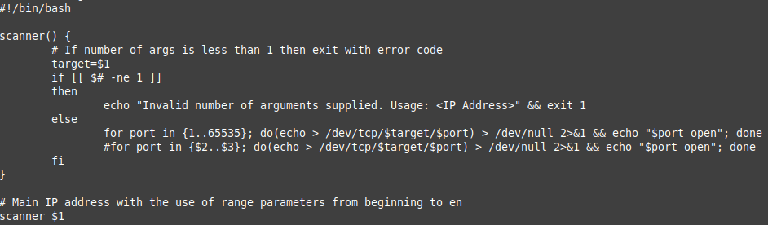
/dev/tcp Port Scanner

Slide 24
The payload
Network socket
IPv6 Address
Interface name
cat < /dev/null > /dev/tcp/fe80::f602:70ff:feb8:a692%em1/8086 && echo “port is open”

Slide 25

Exploit time!

Slide 26
Port scanning firewalled port (/dev/tcp)
InfluxDB can be successfully accessed!
From this point, the IPv6 channel can be further leveraged to attempt password cracking the HTTP authentication endpoint if there are any defences on IPv4 to prevent this.

Slide 27

IPTables in this case…

Slide 28

VLAN Hopping with IPv6
A VLAN hop is unintended access to an isolated segment of an internal network allowing for deeper infiltration.
If devices reply to a link local neighbour call, it is possible to perform a VLAN hop, infiltrating a new network segment.
VLAN Hopping is possible if IPv6 is enabled on a device in a separate VLAN. Link local has its own route different to IPv4, you can verify this via: ip -6 route

Slide 29
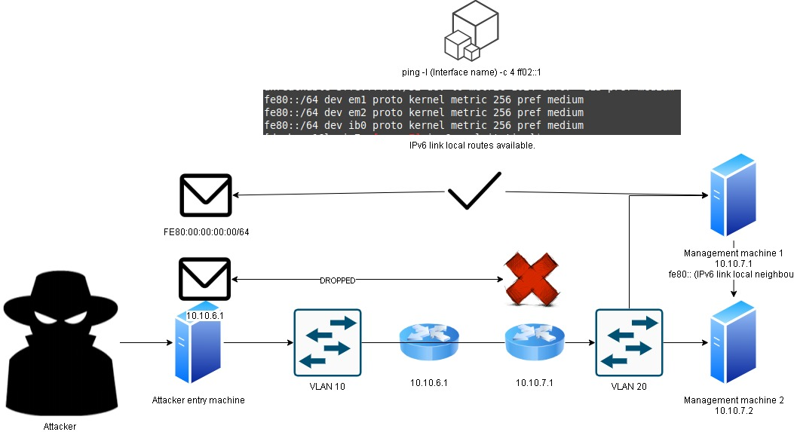
VLAN Hopping via IPv6

Slide 30
Recommended patches (1)
Perform same tests to critical infrastructure machines to test IPv6 access to internally firewalled ports
Remove /dev/tcp capabilities by installing BASH without --enable-net-redirections
If you do not use it, close it/disable it.

Slide 31
Recommended patches (2)
If you use IPv6, then using ip6tables it is recommended to apply the same ruleset as IPv4 to ensure it is not left open as blind spot for exploitation
Always use DROP packets to prevent obvious enumeration

Slide 32

Questions

Slide 33

Next Talk: Linux Network Defence Evasion (Part 2)

Slide 34

Thank you for your time

